Slide 1
Alternative min-max notation for relationship structural constraints
The Structural constraints are represented by Min-Max notation.
This is a pair of numbers (m, n) that appear on the connecting line between the entities and their relationships.
The numbers mean that for each entity e in E, e must participate in at least m and atmost n relationship instances in R at any point in time.
Or
Min (m) refers to the minimum number of instances of an entity that can be associated with an instance of another entity in a relationship.
Max (n) refers to the maximum number of instances of an entity that can be associated with an instance of another entity in a relationship.
If m is 0 it signifies that the entity is participating in the relation partially, whereas, if m is either greater than or equal to 1, it denotes total participation of the entity.

Slide 2
A department has exactly one manager and an employee can manage at most one department.

Slide 3
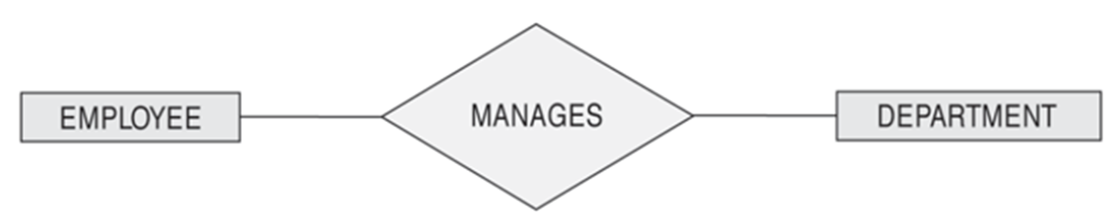
A department has exactly one manager and an employee can manage at most one department.

Slide 4
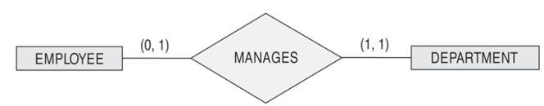
A department has exactly one manager and an employee can manage at most one department.
- Specify (0,1) for participation of EMPLOYEE in MANAGES
- Specify (1,1) for participation of DEPARTMENT in MANAGES

Slide 5
An employee can work for exactly one department but a department can have any number of employees.

Slide 6
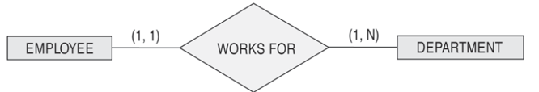
An employee can work for exactly one department but a department can have any number of employees.
- Specify (1,1) for participation of EMPLOYEE in WORKS_FOR
- Specify (1,n) for participation of DEPARTMENT in WORKS_FOR

Slide 7
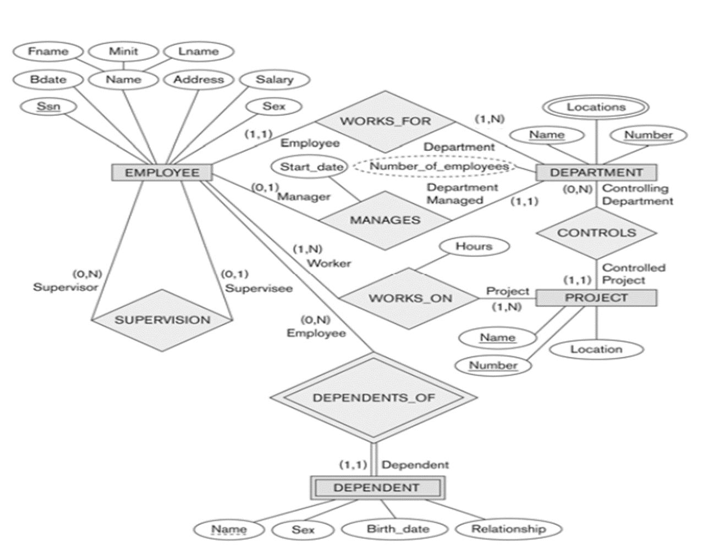

Slide 8
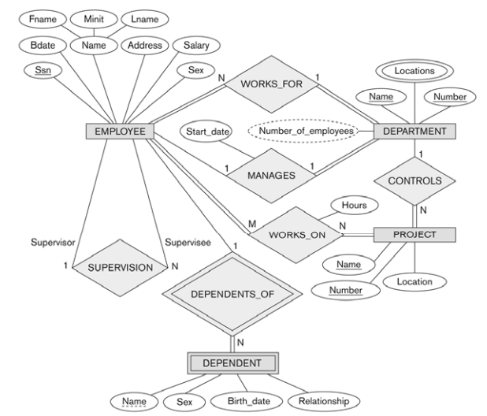

Slide 9
Requirement analysis for a company
The company is organized into departments. Each department has a unique name, a unique number, and a particular employee who manages the department. We keep track of the start date when that employee began managing the department. A department may have several locations.
A department controls a number of projects, each of which has a unique name, a unique number, and a single location.
The database will store each employee’s name, Social Security number, address, salary, sex (gender), and birth date. An employee is assigned to one department, but may work on several projects, which are not necessarily controlled by the same department. It is required to keep track of the current number of hours per week that an employee works on each project, as well as the direct supervisor of each employee (who is another employee).
The database will keep track of the dependents of each employee for insurance purposes, including each dependent’s first name, sex, birth date, and relationship to the employee.

Slide 10
“I would like my customers to be able to browse my catalog of books and place orders over the Internet. Currently, I take orders over the phone. I have mostly corporate customers who call me and give me the ISBN number of a book and a quantity; they often pay by credit card. I then prepare a shipment that contains the books they ordered. If I don’t have enough copies in stock, I order additional copies and delay the shipment until the new copies arrive; I want to ship a customer’s entire order together. My catalog includes all the books I sell. For each book, the catalog contains its ISBN number, title, author, purchase price, sales price, and the year the book was published. Most of my customers are regulars, and I have records with their names and addresses. Draw an ER diagram without any structural constraints.

Slide 11
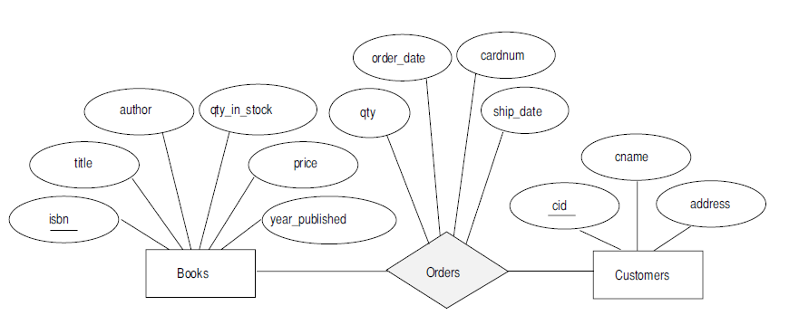

Slide 12
Suppose you are given the following requirements for a simple database for the National Hockey League (NHL): ·
the NHL has many teams,
· each team has a name, a city, a coach, a captain, and a set of players,
· each player belongs to only one team,
· each player has a name, a position (such as left wing or goalie), a skill level, and a set of injury records,
· a team captain is also a player,
· a game is played between two teams (referred to as host_team and guest_team) and has a date (such as May 11th, 1999) and a score (such as 4 to 2).
Draw an ER diagram.

Slide 13
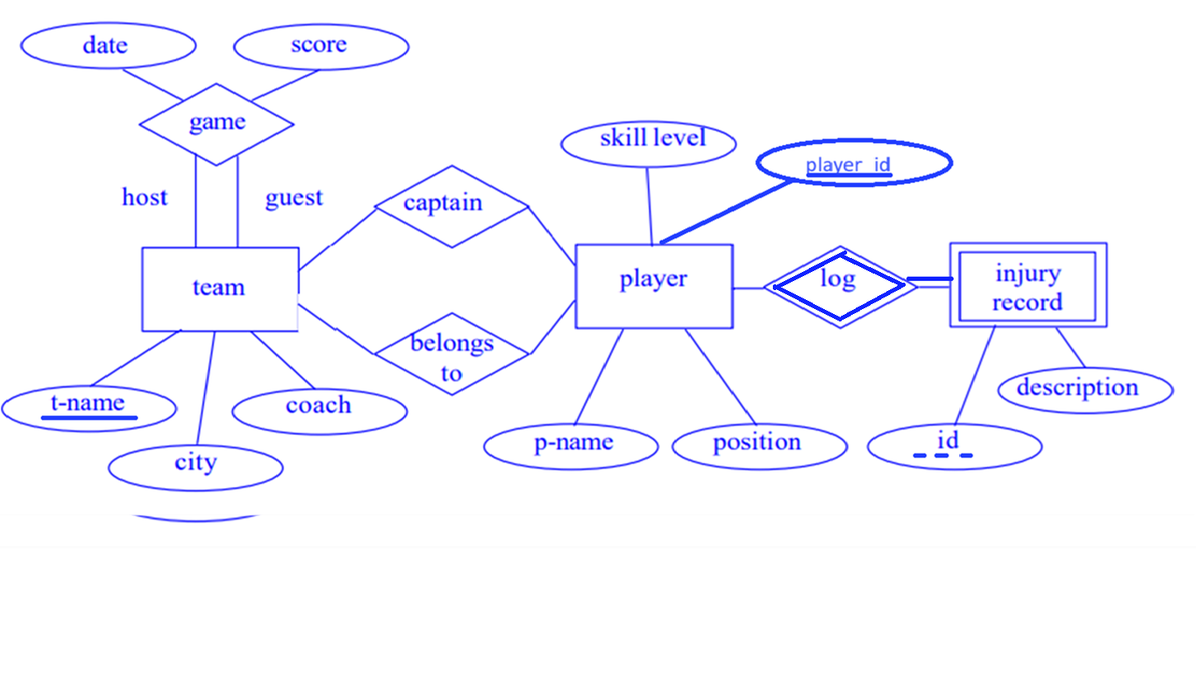

Slide 14
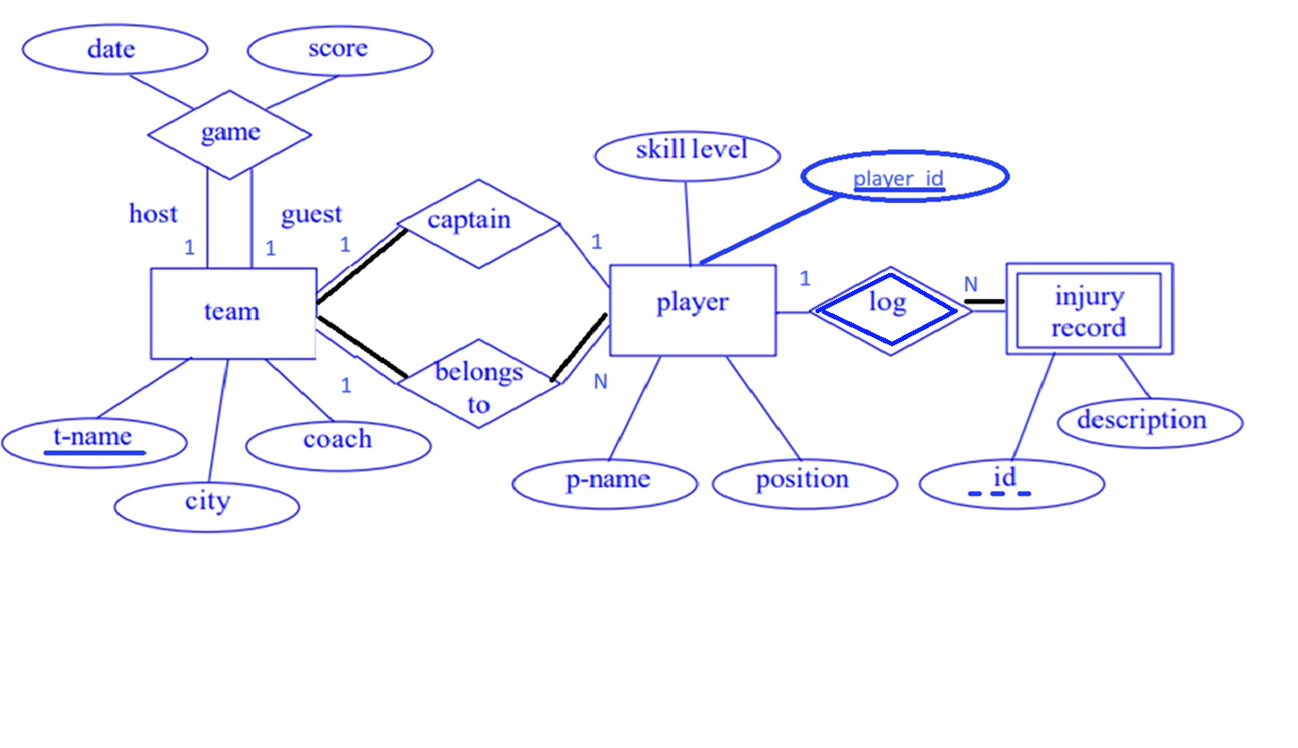

Slide 15
